Slide 1
Classroom Layout
Flexible seating arrangement

Slide 2
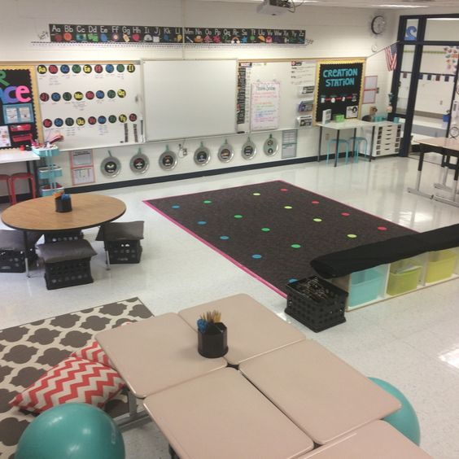

Slide 3
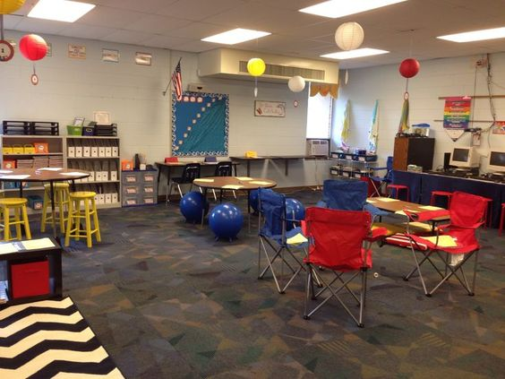
Flexible seating example

Slide 4
Instruction area
Direct instruction shall take place on the carpet in front of an easel, whiteboard or projector.
Students will sit on the carpet, teacher will stand or sit at the easel or whiteboard in clear view.
After direct instruction, students can choose their own seats for guided practice, independent practice, centers, and extension activities.
Teacher will either circulate, or meet with small groups.

Slide 5
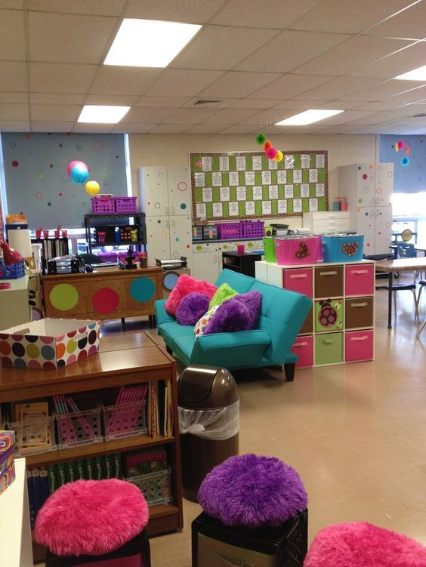
Flexible seating example ii

Slide 6
Evidence based Benefits of flexible seating
Promotes engagement and attentiveness in students.
Improves performance and satisfaction among students.
Allows for personal responsibility and choice.
Promotes individual physical comfort.
Accommodates different learning styles.
Promotes community and collaboration.

Slide 7
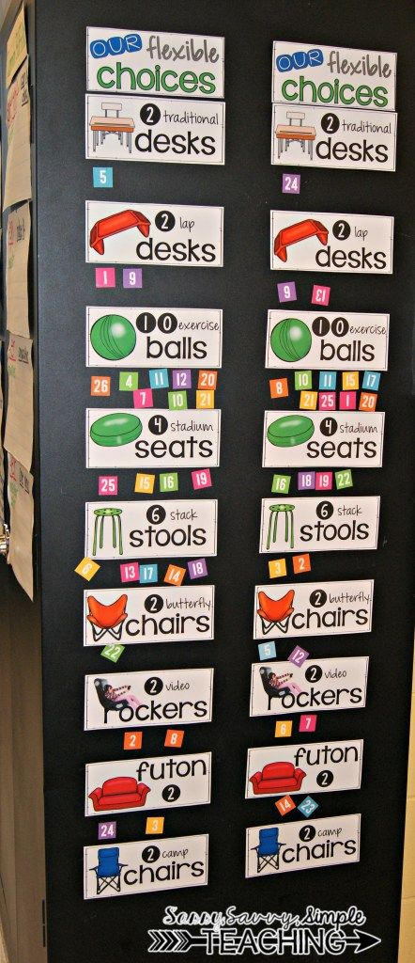
Ideas for flexible seating

Slide 8
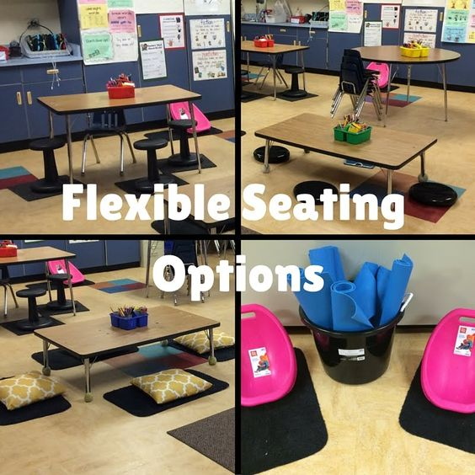

Slide 9
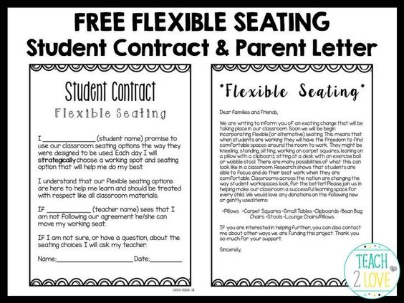

Slide 10
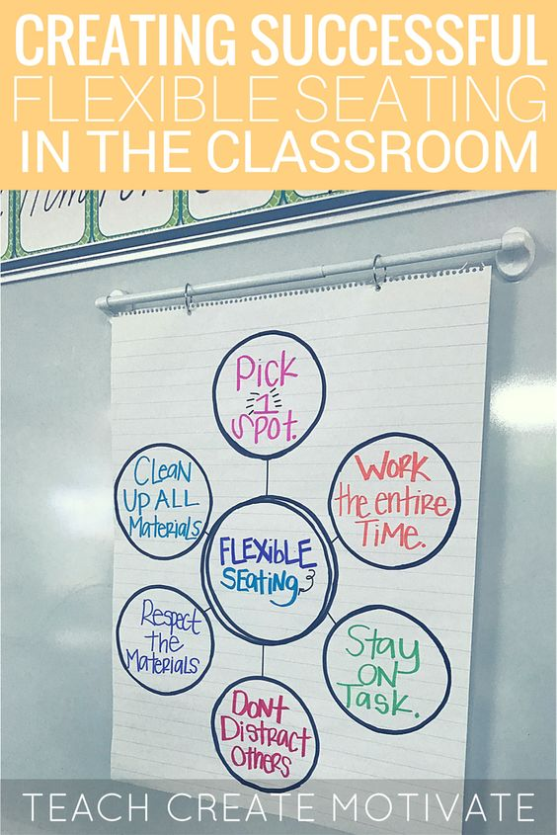

Slide 11
Other considerations
Bookshelves and lockers along the walls will contain class material.
Wall space shall contain bulletin boards of student work, as well as anchor charts.
Laptops or tablet computers with headphones can be used anywhere in the classroom.
Sharpened pencils, and other supplies shall be kept and used communally.
Trash can is located near the door, with an additional trash can on the other side of the room
Procedures for transition and clean up shall be implemented and retaught as needed.

Slide 12
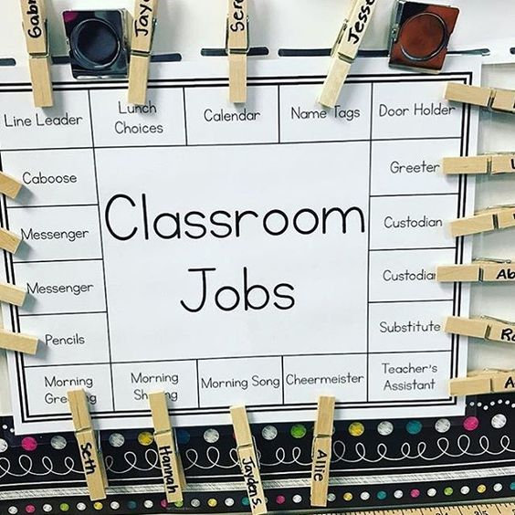

Slide 13
Student jobs
Student jobs will be rotated regularly, so each student has the chance to do each job.
Student jobs can include sharpening pencils, organizing and inventory of materials and supplies, picking up trash, and anything else that needs to be done in the classroom.
Promotes a classroom culture of responsibility and community mindedness.
Reduces burden on teacher.

